Slide 1
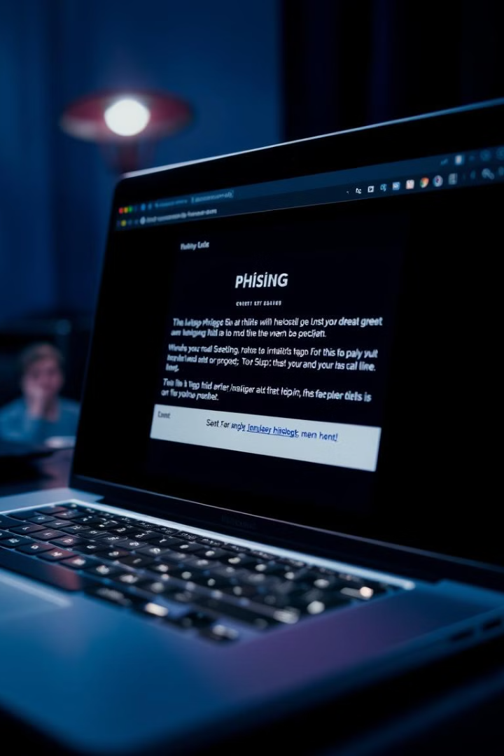
Phishing: Understanding the Threat
Phishing is a common cyberattack that aims to steal your personal information, such as login credentials, bank details, and credit card numbers.
by Tanishq Garg
TG

Slide 2

Phishing Techniques
1
Email Spoofing
2
Pretexting
Attackers create fake emails that mimic legitimate ones from trusted sources, tricking users into clicking malicious links.
This technique involves creating a believable story to gain trust and convince the victim to share sensitive information.
3
Smishing
4
Vishing
Phishing attacks are carried out through text messages, often pretending to be from a bank or service provider.
This involves using phone calls to deceive victims into providing personal information or accessing malicious websites.

Slide 3

Phishing Tools
Metasploit Framework
Social Engineering Toolkit (SET)
A powerful penetration testing framework used for developing and executing phishing attacks.
A comprehensive toolkit for creating and launching phishing campaigns, including email spoofing and website cloning.
Phishing Frenzy
Gophish
A tool that automates phishing campaigns, providing a user-friendly interface for creating and launching attacks.
An open-source phishing framework designed for security testing and training purposes, allowing users to simulate real-world phishing attacks.

Slide 4
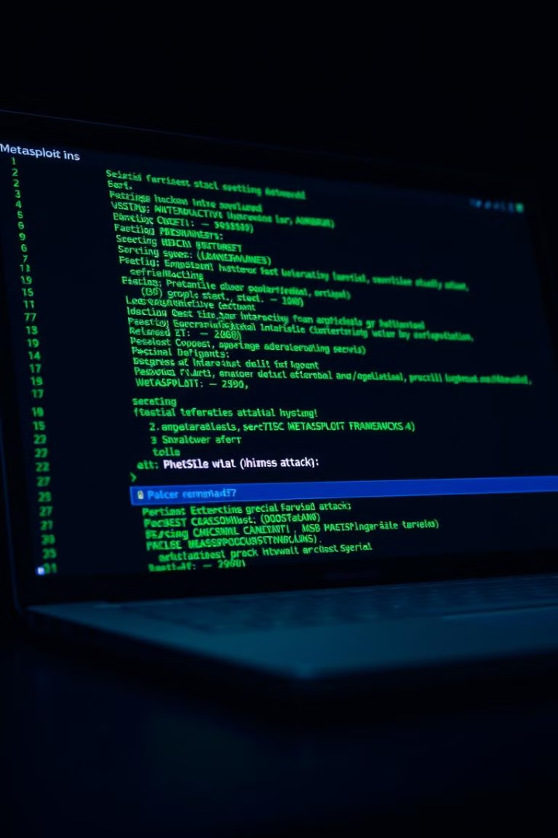
Metasploit Framework
1
Payload Development
Metasploit allows attackers to create custom payloads designed to exploit specific vulnerabilities.
2
Exploit Creation
Attackers can use Metasploit to create custom exploits targeting specific software and operating systems.
3
Attack Execution
Metasploit provides tools for launching phishing attacks and managing the infected systems.
4
Post-Exploitation
The framework helps attackers gain access to sensitive information and maintain persistence on the compromised systems.

Slide 5
Social Engineering Toolkit (SET)
Email Spoofing
Website Cloning
Credential Harvesting
SET can create realistic emails that mimic legitimate ones from trusted sources.
This tool allows attackers to create fake websites that look identical to the real ones, enticing users to enter their credentials.
SET can be used to capture user credentials entered on fake websites and forms, allowing attackers to gain access to sensitive information.

Slide 6
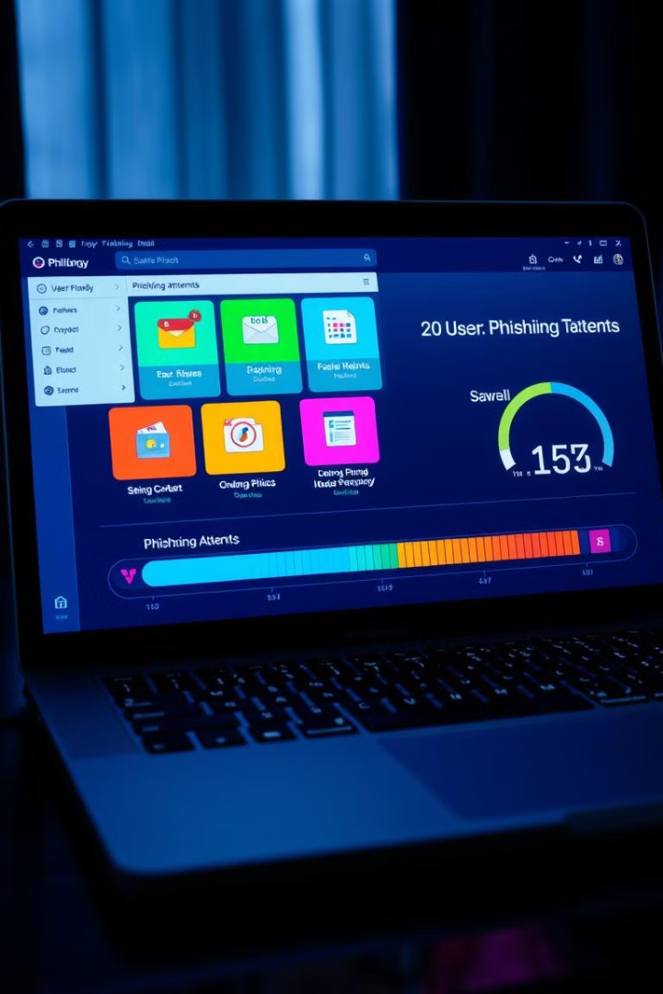




Phishing Frenzy
Campaign Creation
Phishing Frenzy makes it easy to create and configure phishing campaigns.
Email Sending
This tool allows attackers to send phishing emails to targeted individuals or organizations.
Result Tracking
Phishing Frenzy provides features for monitoring campaign performance and analyzing attack results.
Report Generation
This tool offers the ability to generate reports detailing successful phishing attempts and captured credentials.

Slide 7
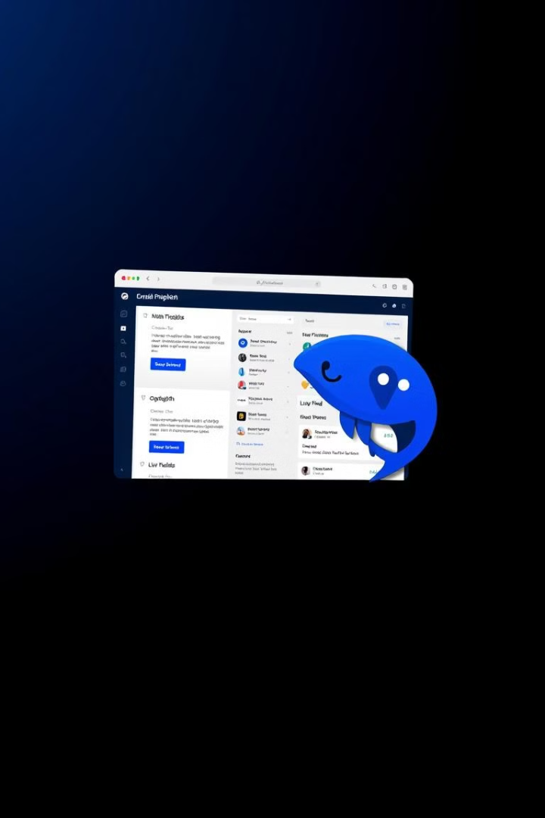
Gophish
Open-Source
Gophish is an open-source platform, making it accessible and customizable.
Security Testing
It allows security professionals to simulate phishing attacks and evaluate their organization's vulnerability.
Training Purposes
Gophish is used to train employees and users on identifying and avoiding phishing attacks.
Real-World Simulation
This framework simulates real-world phishing scenarios, enabling organizations to test their security measures.

Slide 8





Conclusion and Recommendations
Strong Passwords
Email Verification
Phishing Awareness
Software Updates
Use strong passwords and avoid reusing the same password across different accounts.
Be cautious of suspicious emails, verify the sender, and avoid clicking on unfamiliar links.
Educate yourself and your organization about phishing attacks and their prevention strategies.
Keep your software and operating systems up to date to patch vulnerabilities and prevent exploits.

Slide 9
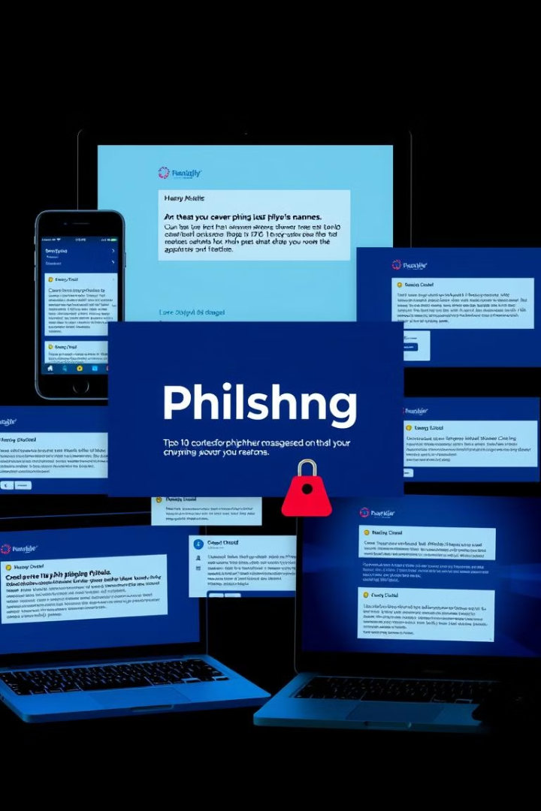
Emails, Website, SMS, Phishing
Attackers use multiple channels to deliver phishing messages, including emails, websites, SMS, and even social media.

Slide 10
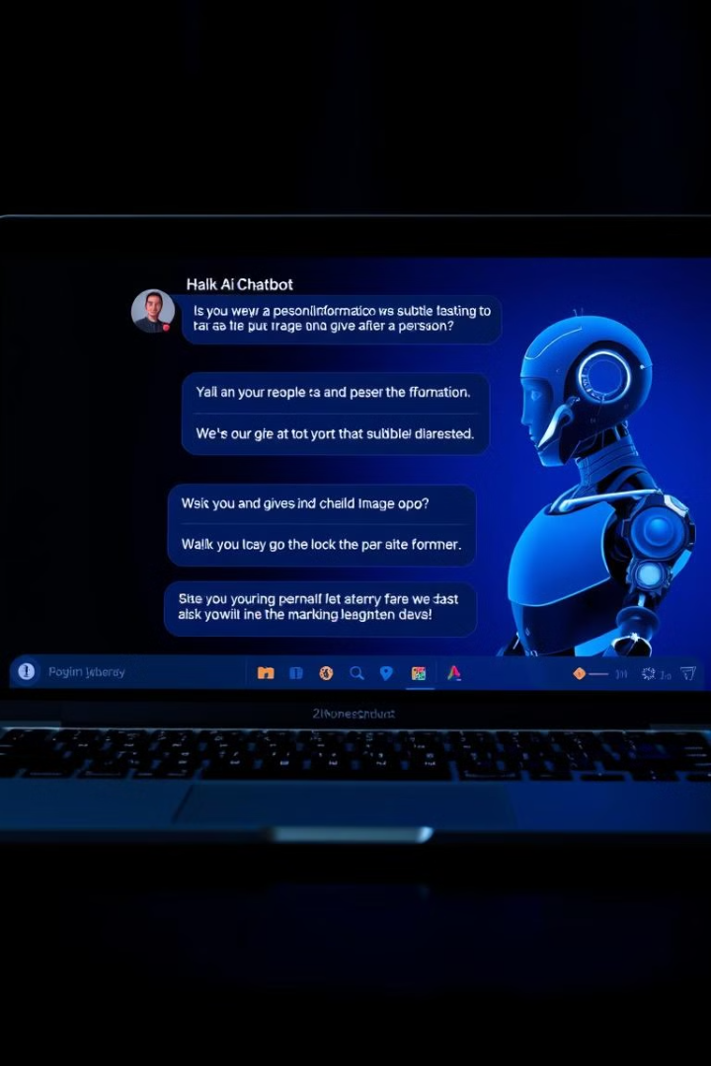
Phishing with AI
Artificial intelligence is being used to create more sophisticated phishing attacks, making them harder to detect and more convincing.

